Slide 1






Web Technologies Development Project – Team 13

Slide 2
WELCOME

Slide 3
WELCOME

Slide 4
WELCOME
WELCOME

Slide 5
WELCOME

Slide 6
WELCOME

Slide 7
WELCOME
WELCOME

Slide 8
WELCOME

Slide 9
WELCOME

Slide 10
WELCOME

Slide 11


TEAM
Alexander Nguyen
Joseph Sumlin
Totti Nguyen
Jamie Lopez
Goutham Ganapathiappan

Slide 12
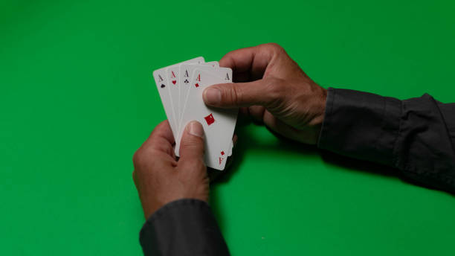

Slide 13
Card Game Interface
Designing a responsive and visually engaging card game interface with smooth animations to enhance user experience and engagement in a digital card game.

Slide 14

The Problem addressed:
User Engagement: By creating a visually appealing card game interface with smooth animations, you address the challenge of engaging users and making the gaming experience enjoyable. The animations make the game more interactive and immersive, encouraging players to continue playing.
Responsive Design: Responsive design ensures that the card game interface looks and functions well on various devices and screen sizes. It addresses the problem of accommodating users with different devices, such as desktops, tablets, and smartphones, by providing a consistent and user-friendly experience.
User Experience (UX): Smooth animations, intuitive buttons, and a well-structured layout contribute to a positive user experience. Addressing UX problems means making the interface user-friendly and easy to navigate, which can enhance user satisfaction and retention.

Slide 15
The Problem addressed:
User Engagement: By creating a visually appealing card game interface with smooth animations, you address the challenge of engaging users and making the gaming experience enjoyable. The animations make the game more interactive and immersive, encouraging players to continue playing.
Responsive Design: Responsive design ensures that the card game interface looks and functions well on various devices and screen sizes. It addresses the problem of accommodating users with different devices, such as desktops, tablets, and smartphones, by providing a consistent and user-friendly experience.
User Experience (UX): Smooth animations, intuitive buttons, and a well-structured layout contribute to a positive user experience. Addressing UX problems means making the interface user-friendly and easy to navigate, which can enhance user satisfaction and retention.

Slide 16
The Problem addressed:
User Engagement: By creating a visually appealing card game interface with smooth animations, you address the challenge of engaging users and making the gaming experience enjoyable. The animations make the game more interactive and immersive, encouraging players to continue playing.
Responsive Design: Responsive design ensures that the card game interface looks and functions well on various devices and screen sizes. It addresses the problem of accommodating users with different devices, such as desktops, tablets, and smartphones, by providing a consistent and user-friendly experience.
User Experience (UX): Smooth animations, intuitive buttons, and a well-structured layout contribute to a positive user experience. Addressing UX problems means making the interface user-friendly and easy to navigate, which can enhance user satisfaction and retention.

Slide 17
The Problem addressed:
Realism and Immersion: Creating a realistic card layout with animations for shuffling and dealing cards helps users feel more immersed in the game. It addresses the challenge of making a digital card game feel like a real-world experience, enhancing player enjoyment and engagement.
Aesthetics and Visual Appeal: The card game interface's visual design, including card aesthetics and smooth animations, addresses the challenge of making the game visually attractive. Aesthetically pleasing interfaces can attract more users and keep them engaged.
Responsive Interactivity: Interactive elements, like buttons, allow users to control the game. Addressing this problem involves providing a means for users to initiate actions, such as shuffling the deck or dealing cards, in an intuitive and responsive manner.

Slide 18
The Problem addressed:
Realism and Immersion: Creating a realistic card layout with animations for shuffling and dealing cards helps users feel more immersed in the game. It addresses the challenge of making a digital card game feel like a real-world experience, enhancing player enjoyment and engagement.
Aesthetics and Visual Appeal: The card game interface's visual design, including card aesthetics and smooth animations, addresses the challenge of making the game visually attractive. Aesthetically pleasing interfaces can attract more users and keep them engaged.
Responsive Interactivity: Interactive elements, like buttons, allow users to control the game. Addressing this problem involves providing a means for users to initiate actions, such as shuffling the deck or dealing cards, in an intuitive and responsive manner.

Slide 19
The Problem addressed:
Realism and Immersion: Creating a realistic card layout with animations for shuffling and dealing cards helps users feel more immersed in the game. It addresses the challenge of making a digital card game feel like a real-world experience, enhancing player enjoyment and engagement.
Aesthetics and Visual Appeal: The card game interface's visual design, including card aesthetics and smooth animations, addresses the challenge of making the game visually attractive. Aesthetically pleasing interfaces can attract more users and keep them engaged.
Responsive Interactivity: Interactive elements, like buttons, allow users to control the game. Addressing this problem involves providing a means for users to initiate actions, such as shuffling the deck or dealing cards, in an intuitive and responsive manner.

Slide 20
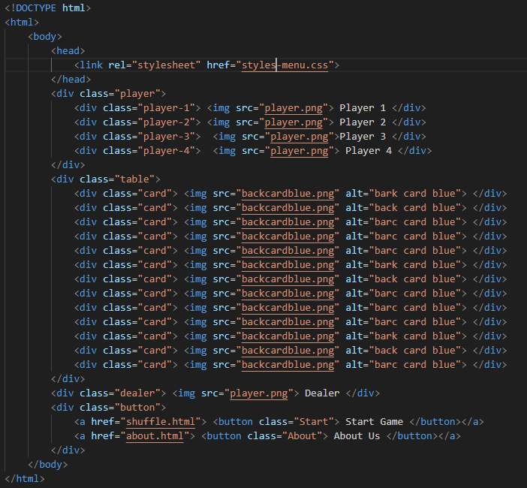
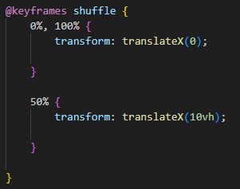
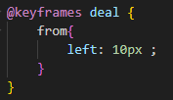
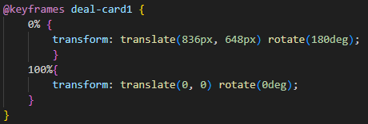
Code Screenshots
LINKEDIN
TTHIS IS Davinci Resolve
SFEGSHRHRH
Easy to code
3rd most popular language in the world
Top 15% programming professionals have python certification
57% of Job Seekers Use LinkedIn to Find New Job Opportunities
61 Million Users Look for Jobs Through LinkedIn Weekly
Over 58 Million Companies Are On LinkedIn

Slide 21
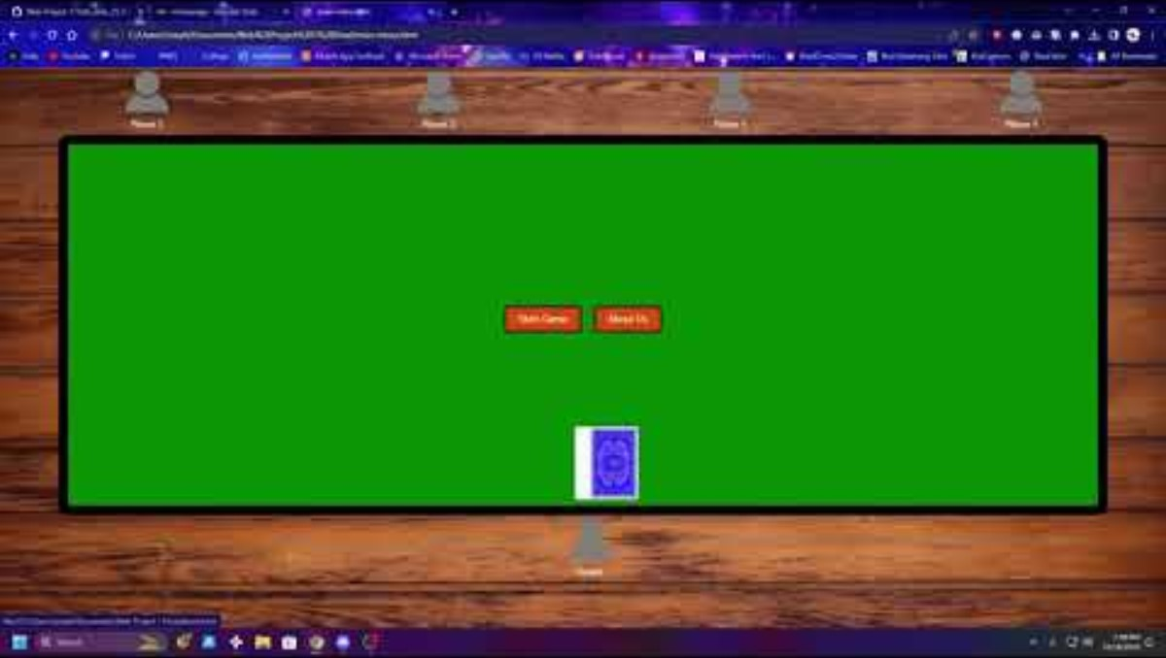
Demo Run
LINKEDIN
DAVINCI RESOLVE
TTHIS IS Davinci Resolve
SFEGSHRHRH
Easy to code
3rd most popular language in the world
Top 15% programming professionals have python certification
57% of Job Seekers Use LinkedIn to Find New Job Opportunities
61 Million Users Look for Jobs Through LinkedIn Weekly
Over 58 Million Companies Are On LinkedIn

Slide 22
FEATURES
Card Layout and Animation
User Interaction
Responsive Design
HTML: Create a card container structure using <div> elements to represent individual cards. Use nested <div> elements for the card's front and back, with appropriate classes or data attributes to identify each card's value and suit.
CSS: Apply CSS styles to these card elements, including card dimensions, borders, shadows, and background colors to simulate a realistic card appearance. Implement smooth animations, like transitions or keyframes, to create effects such as flipping a card when it's dealt or shuffling the deck.
HTML: Add interactive elements like buttons for actions such as shuffling the deck and dealing cards. Use <button> elements with appropriate labels and classes.
CSS: Apply CSS styles to these buttons, including hover effects, and possibly use CSS transitions or animations to make the buttons respond to user interactions with smooth and visually appealing effects
HTML: Structure the overall game interface using HTML elements that allow for responsive design, such as using a flexbox or grid layout to arrange cards and buttons. Utilize media queries to adapt the layout for various screen sizes and orientations.
CSS: Implement responsive CSS rules to ensure that the card game interface adapts gracefully to different screen sizes and devices. This may involve adjusting the card size, spacing, or button placement as the viewport size changes.

Slide 23
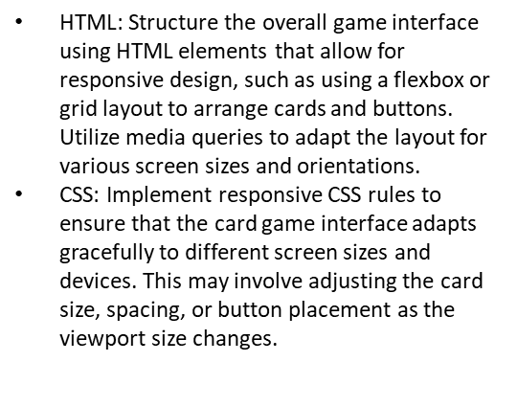
FEATURES
Card Layout and Animation
HTML: Add interactive elements like buttons for actions such as shuffling the deck and dealing cards. Use <button> elements with appropriate labels and classes.
CSS: Apply CSS styles to these buttons, including hover effects, and possibly use CSS transitions or animations to make the buttons respond to user interactions with smooth and visually appealing
Responsive Design
User Interaction
HTML: Create a card container structure using <div> elements to represent individual cards. Use nested <div> elements for the card's front and back, with appropriate classes or data attributes to identify each card's value and suit.
CSS: Apply CSS styles to these card elements, including card dimensions, borders, shadows, and background colors to simulate a realistic card appearance. Implement smooth animations, like transitions or keyframes, to create effects such as flipping a card when it's dealt or shuffling the deck.

Slide 24

FEATURES
Responsive Design
Card Layout and Animation
User Interaction
HTML: Create a card container structure using <div> elements to represent individual cards. Use nested <div> elements for the card's front and back, with appropriate classes or data attributes to identify each card's value and suit.
CSS: Apply CSS styles to these card elements, including card dimensions, borders, shadows, and background colors to simulate a realistic card appearance. Implement smooth animations, like transitions or keyframes, to create effects such as flipping a card when it's dealt or shuffling the deck
HTML: Structure the overall game interface using HTML elements that allow for responsive design, such as using a flexbox or grid layout to arrange cards and buttons. Utilize media queries to adapt the layout for various screen sizes and orientations.
CSS: Implement responsive CSS rules to ensure that the card game interface adapts gracefully to different screen sizes and devices. This may involve adjusting the card size, spacing, or button placement as the viewport size changes

Slide 25


Communication

Slide 26
Summary
The project aims to create an immersive and user-friendly digital card game interface by implementing a responsive design with elegant card layouts and smooth animations. It addresses the challenge of engaging users with an interactive and visually appealing gaming experience while ensuring that the interface adapts seamlessly to various devices and screen sizes. The primary goal is to enhance user experience, making the digital card game feel realistic and enjoyable, ultimately resulting in higher user engagement and satisfaction.

Slide 27


Slide 28
Required Links:
Presentation: https://youtu.be/fvSCaxGHSpI
CODD: https://codd.cs.gsu.edu/~jsumlin3/WP/PW/1/main-menu.html
GitHub: https://github.com/JSumlin/Web-Project-1

